Slide 1

EC-101 Basics of Electronics & Communication Engineering
Module-4
By
Dr. Priyank Saxena
Assistant Professor

Slide 2
Course Syllabus
Module-3 : Sinusoidal Oscillators Sinusoidal Oscillators: Concept of positive and negative feedback, Barkhausen criterion for sustained oscillations, Determination of Frequency and Condition of oscillation, Hartley and Colpitt’s oscillator. Operational Amplifiers: Operational Amplifiers: Characteristics of an Ideal and Practical Operational Amplifier (IC 741), Inverting and non-inverting amplifiers, Offset error voltages and currents; Power supply rejection ratio, Slew Rate and concept of Virtual Ground, Summing and Difference Amplifiers, Differentiator and Integrator, RC phase shift oscillator. {8 Lect. hours}
Module-4 : Logic Gates and Boolean Algebra Logic Gates and Boolean algebra: Introduction to Boolean Algebra and Boolean operators, Symbolic representation, Boolean algebraic function and Truth table of different Digital logic Gates (AND, OR, NOT, NAND, NOR, EX- OR, EX-NOR); Realization of Basic logic gates using universal gates, Adder, Subtractor, adder/subtractor. {8 Lect. hours}

Slide 3
Advantages of Digital System
As digital system work with discrete quantities, they are easier to design. Exact values of voltage or current are not important, only the range is important.
Information storage is easy.
Accuracy and precision are greater.
Digital circuits are less affected by noise.
More digital circuitry can be fabricated on IC chips.
Image processing.

Slide 4
Limitations of Digital System
The main drawback of digital system comes from the fact that, the real world is mainly analog. Most physical quantities are analog in nature, and these are the quantities which are often inputs and outputs that are monitored, operated and controlled by a system.
To take the advantage of digital techniques, when dealing with analog inputs and outputs, three steps can be followed-
Convert the real-world analog inputs to a digital form (ADC),
Process the digital information,
Convert the digital outputs back to real world analog form (DAC)

Slide 5
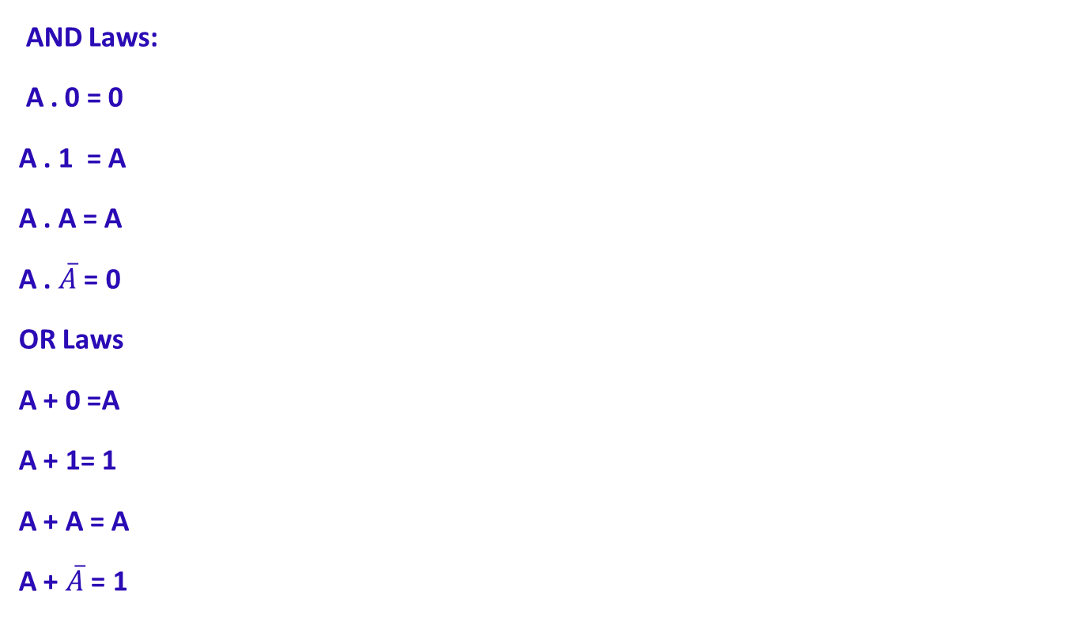
Binary Arithmetic

Slide 6
Boolean Algebra
Boolean algebra is a mathematical system for the manipulation of variables that can have one of two values.
In formal logic, these values are “true” and “false.”
In digital systems, these values are “on” and “off,” 1 and 0, or “high” and “low.”
Boolean expressions are created by performing operations on Boolean variables.
Common Boolean operators include AND, OR, and NOT.
The electronic circuit which performs/implement these Boolean logic operation are known as LOGIC GATE.

Slide 7
Postulates of Boolean Algebra
A Boolean function has:
At least one Boolean variable,
At least one Boolean operator, and
At least one input from the set {0,1}.
It produces an output that is also a member of the set {0,1}.

Slide 8
Postulates of Boolean Algebra
Boolean Algebra is an algebraic structure defined on a set of elements B together with two binary operators ‘+’ and ‘.’ provided the following (Huntington) postulates are satisfied
Postulate 1: Closure Property: For every A, B ϵ S
(i) D = A + B and D ϵ S: This is the closure property for OR operation.
(ii) G = A.B and G ϵ S: This is the closure property for AND operation.
Postulate 2: Commutative Law: If A and B ϵ S then
(i) A + B = B + A
(ii) A . B = B . A

Slide 9
Postulates of Boolean Algebra
Postulate 3: Identity Element:
The identity element for OR operator is 0, if A ϵ S and 0 ϵ S
then A + 0 = 0 + A = A : 0 is known as addition identity.
(ii) The identity element for AND operator is 1, if A ϵ S and 1 ϵ S
then A . 1 = 1 . A = A : 1 is known as multiplication identity.
Postulate 4: Distributive Law: If A, B, C ϵ S then
(i) A . (B + C) = A . B + A . C
(ii) A + B . C = (A + B) . (A + C)
Postulate 5: Complementing Law: If A ϵ S, there exist an element (known as complement of a) which belong to S ( ϵ S ) such that
A+ = 1
(ii) A . = 0
Postulate 6 : There are at least two elements A , B Î S such that A ≠ B .

Slide 10
Boolean algebra Vs ordinary algebra
Boolean algebra differs with ordinary algebra on the following points:
The associative law doesn’t include in Huntington postulates but holds for boolean algebra
2. The distributive law A + B . C = (A + B) . (A + C) does not hold in ordinary
algebra.
3. Complementing law does not hold in ordinary algebra, i.e., there is no
equivalent of the unary operator (NOT operation) in ordinary algebra.
4. Boolean algebra does not have the additive inverse and multiplicative
inverse due to which no subtraction or division operations exist.
5. Boolean algebra has only finite set of elements where as the ordinary
algebra deals with real numbers which constitute a set with infinite number of
elements.
Switching algebra, a special class of Boolean algebra however, deals with two valued elements.
In Boolean algebra the elements should have the values 0 and 1 only.

Slide 11
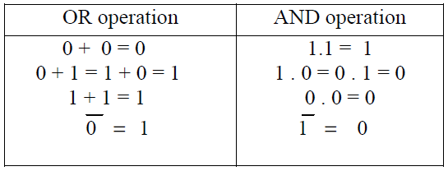


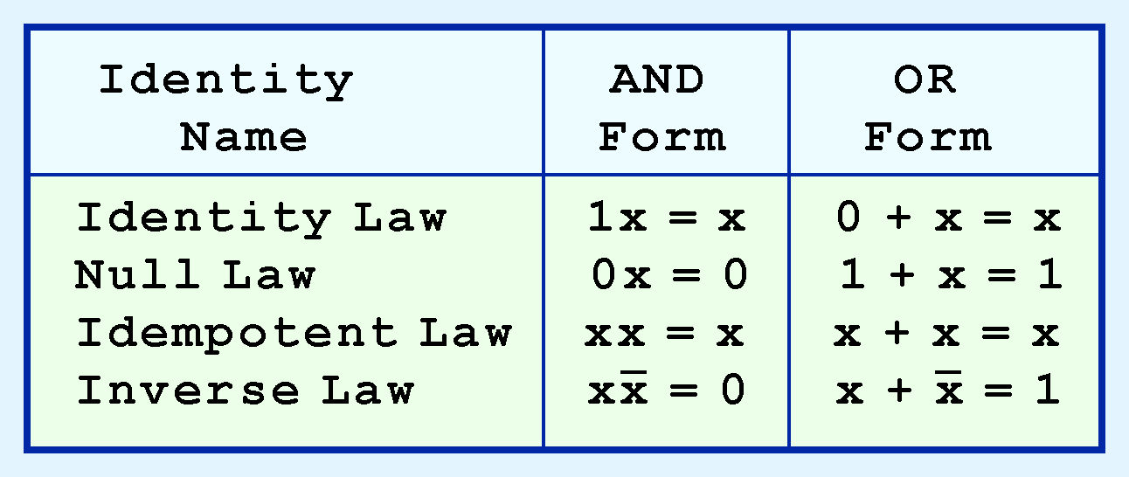
Two – Valued Boolean Algebra:
The postulates of special class of Boolean algebra known as two valued Boolean algebra or switching algebra, if a set of two elements 0 & 1 are assumed.
The postulates are summarized below: This first group is rather intuitive:
These postulates are also given in the general form as:

Slide 12
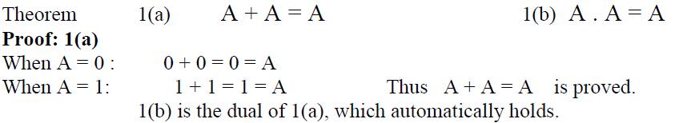

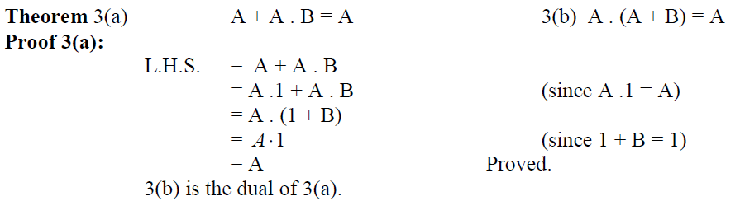
Theorems of Boolean Algebra
The following are the general theorems or rules of Boolean algebra:
This theorem 3 (a) and (b) is also called as absorption theorem.

Slide 13


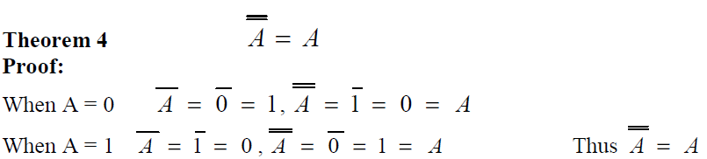
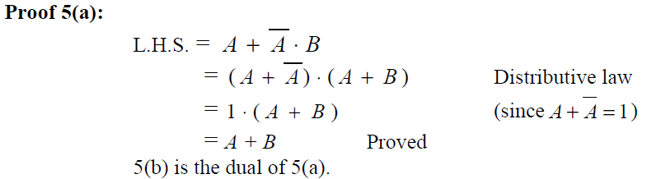
Theorems of Boolean Algebra
Corollary of the absorption theorem is given as follows:
This theorem is also called second absorption theorem.
Corollary of theorem 5 is given as

Slide 14
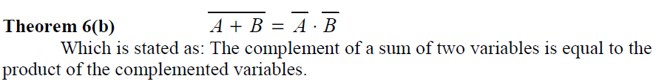
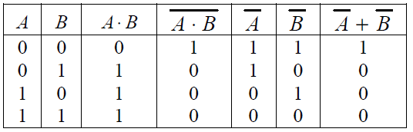
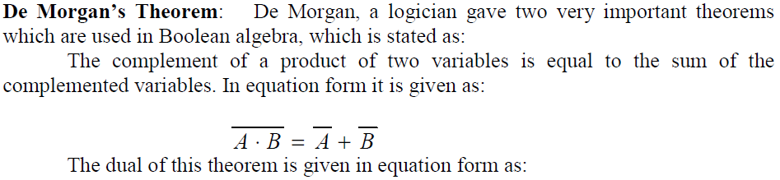

Theorems of Boolean Algebra

Slide 15

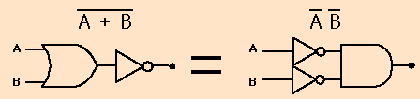
DeMorgan’s Theorem
(a) Complement of product of two or more Boolean numbers is equivalent to sum of complement of those Boolean numbers
A NAND gate is equivalent to an inversion followed by an OR
(b) Complement of sum of two or more Boolean numbers is equivalent to product of complement of those Boolean numbers
A NOR gate is equivalent to an inversion followed by and AND

Slide 16
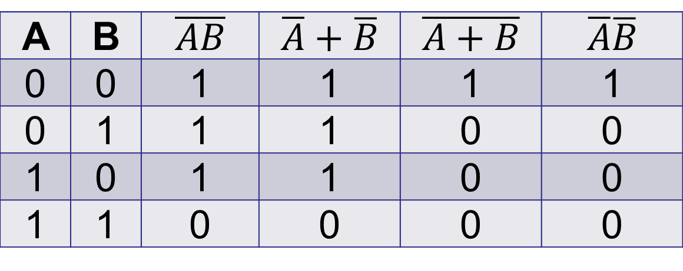
DeMorgan Truth Table
A | B
0 | 0 | 1 | 1 | 1 | 1
0 | 1 | 1 | 1 | 0 | 0
1 | 0 | 1 | 1 | 0 | 0
1 | 1 | 0 | 0 | 0 | 0
NAND
NOR
Duality Principle
According to this principle
“It states that every algebraic expression deducible from the postulates of Boolean algebra remain valid if the operators and the identity elements are interchanged”
So, the postulates or theorems of:-
Boolean algebra are given for one type of operation may be converted to other type of operation (i.e. OR to AND or vice versa) just by interchanging 0 with 1 and ‘+’ with ‘.’
This principle ensures that if a theorem is proved using the postulates of Boolean algebra then dual of this theorem automatically holds and need not to be proved separately.

Slide 17
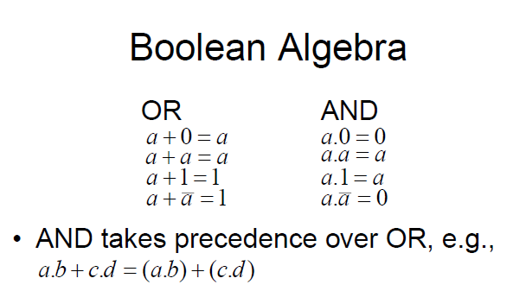
Boolean Algebra

Slide 18
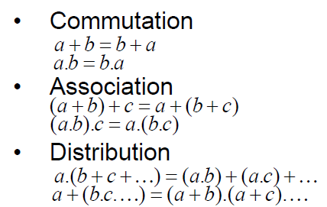

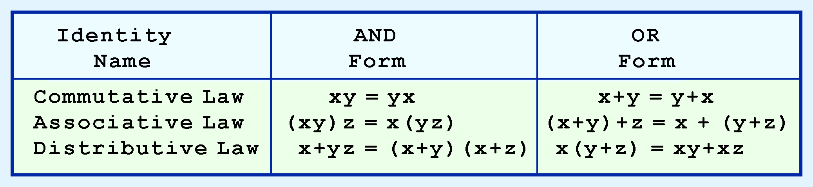
Boolean Algebra (Cont.)

Slide 19


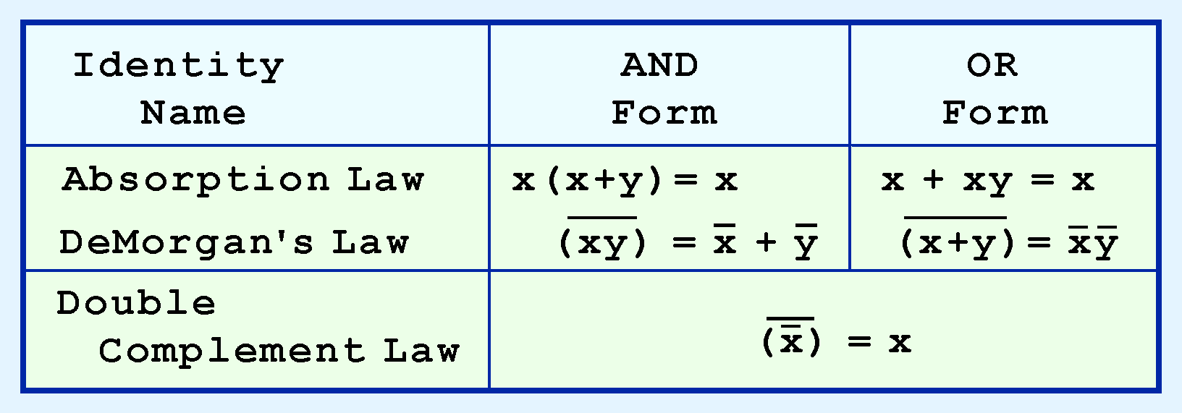
Boolean Algebra (Cont.)

Slide 20

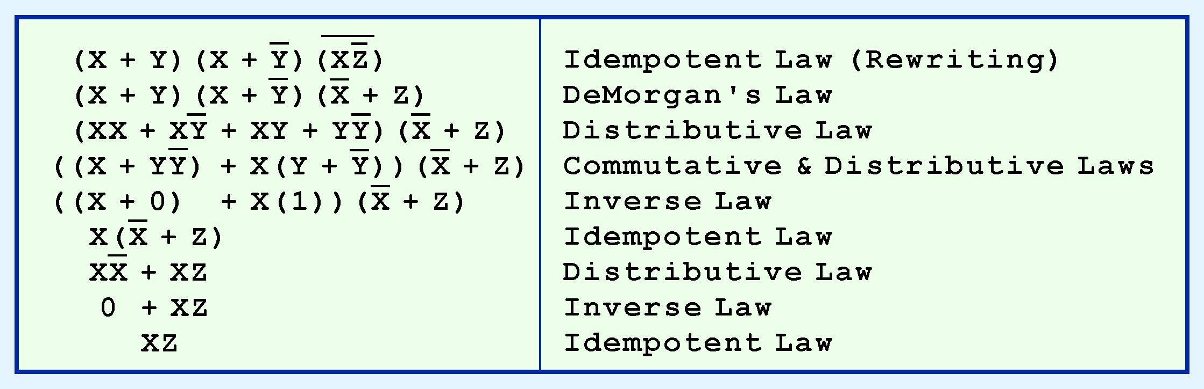
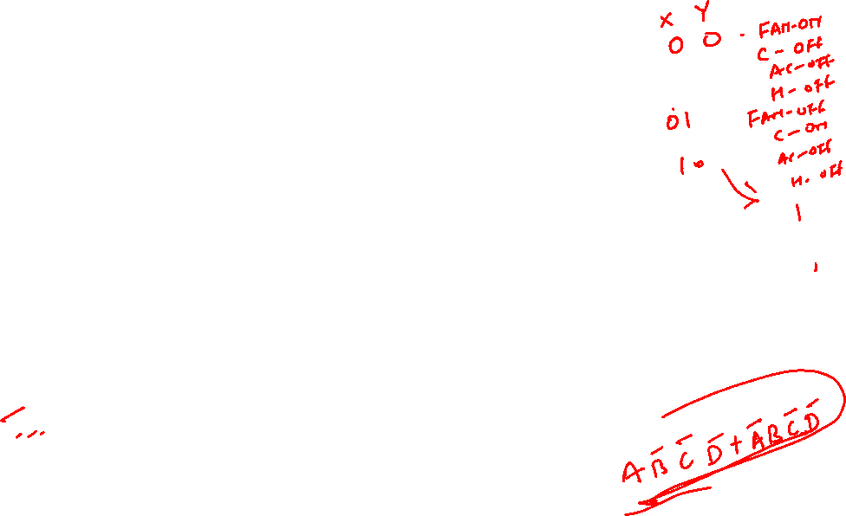
Simplifying Algebraic Expressions
Algebraic manipulation
We can use Boolean identities to simplify the function:
as follows:

Slide 21
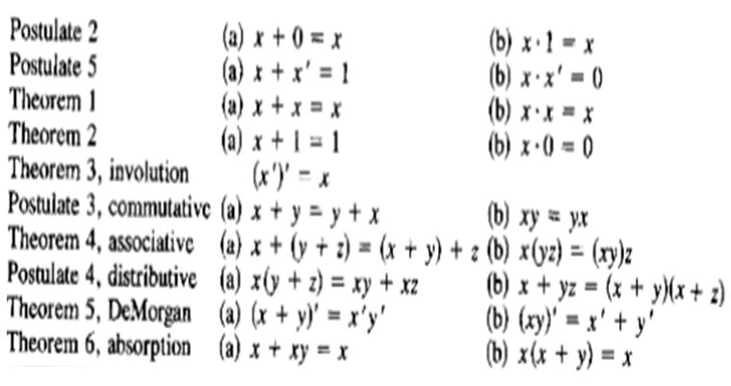

Postulates and theorems of Boolean Algebra

Slide 22
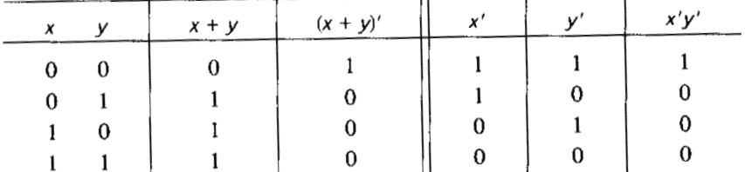

Operator Precedence
The Operator Precedence for evaluating Boolean expression is
Parentheses
NOT
AND
OR
So the expression inside the parentheses must be evaluated first before all other operations. The next operation precedence is the complement operator.
Then follows the AND and finally the OR operation is considered
For example in the truth table for Demorgon’s theorem.
LHS expression is (x+y)’, therefore the expression inside the parentheses is evaluated first and the result then complemented.
The right side of the expression is x’y’. Therefore the complement of x and complement of y both are evaluated first and the result is then ANDed

Slide 23
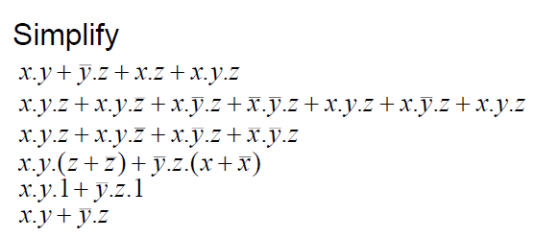
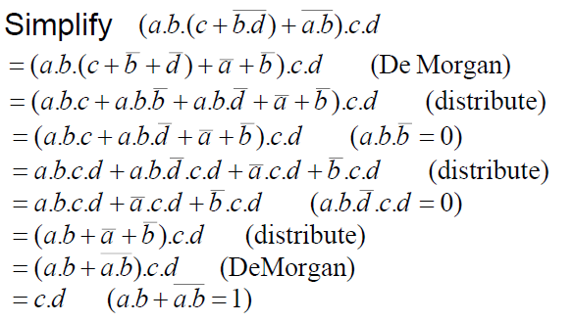
Boolean Algebra (Cont.)

Slide 24
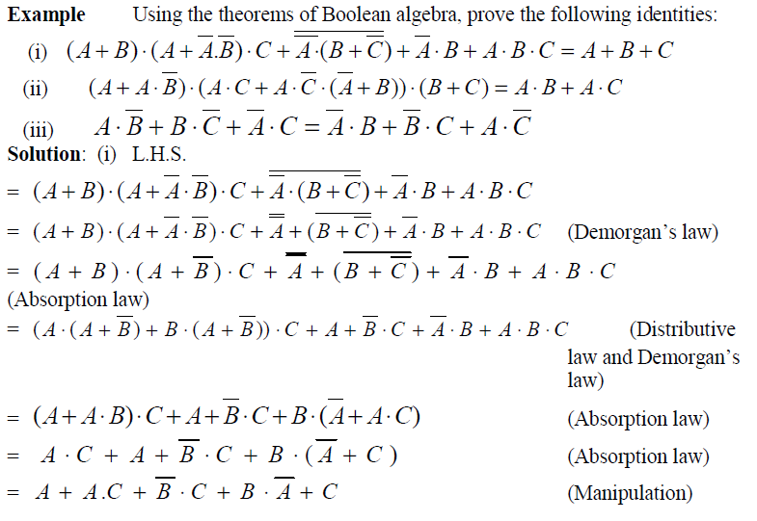



Slide 25
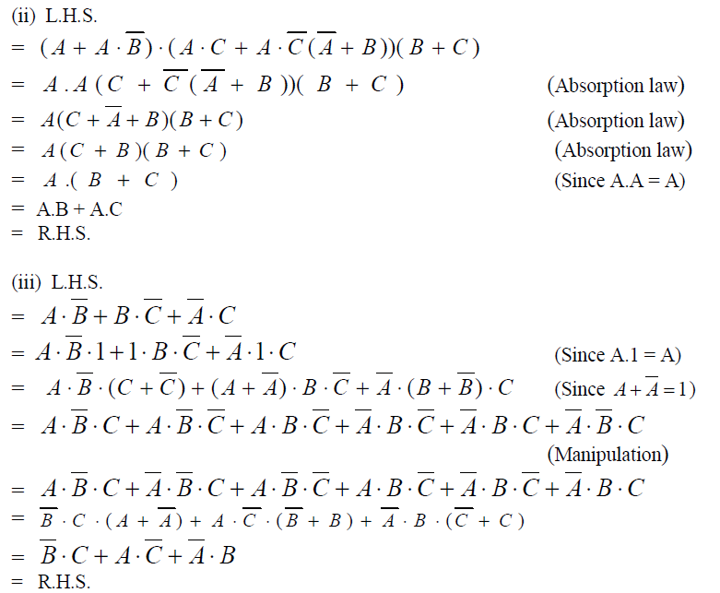

Slide 26
Simplifying Algebraic Expressions
Logic Minimization
Two methods of simplifying algebraic expressions are the map method and tabular method.
The map method is used for functions up to six variable.
The map method is also known as the Karnaugh map or k-map Method.
To manipulate functions of many variables , the tabular method is used which is also known as Quine-McCluskey method.

Slide 27

Logic Minimization
Minimization is the process of reducing a complex logic expression or equation into a simpler form with fewer terms by removing redundancies and terms having no effect on the output.
This is like simplifying and reducing complex algebraic expressions by collecting and combining like terms.
As in algebraic reduction, rules must be followed that guarantee the value of the expression is not changed by the simplification.
Any Boolean function can be implemented directly using combinational logic (gates).
However, simplifying the Boolean function will enable the number of gates required to be reduced.
Available Minimization Techniques include:
– Algebraic manipulation (see in some previous slides examples)
– Karnaugh (K) mapping (a visual approach)
– Tabular approaches (usually implemented by computer, e.g., Quine-
McCluskey method)
K mapping is the preferred technique for up to about 4-5 variables

Slide 28

Product and Sum of Product (SOP) Term
A Product term is the entity of the binary expression, which associates multiple literals (variable or its complement) together in single item/entity using Product operator (.)
Exp.: A' B , B' C‘ , A B' C etc.
SOP Term: The Sum expression formed by combining product terms using sum operators are known as sum of product (SOP) terms
Exp.: A' B + B' C' + A B' C
SUM and product of sum (POS)Term
A SUM term is the entity of the binary expression, which associates multiple literals (variable or its complement) together in single item/entity using SUM operator (+)
Exp.: A‘ + B , B‘ + C‘ , A + B' + C etc.
POS Term: The Product expression formed by combining Sum terms using Product operators are known as product of sum (POS) terms
Exp.: (A' + B). (B' + C‘) + (A +B'+ C)

Slide 29
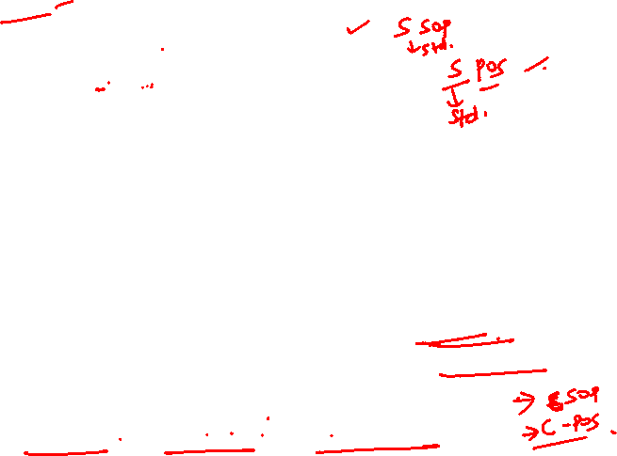
Standard Forms
A Boolean function F( ) can be expressed in simplified form in which the term of the function does not contains all variables (in either complement or uncomplemented form, literals). This form of the Boolean function is known as ‘Standard Form’
F = A' B + B' C' + A B' C
F = (A + B) (A + B + C’) • (A + B‘ )
Canonical Form
Any Boolean function F( ) can be expressed as a unique sum of minterms* and a unique product of maxterms**) (under a fixed variable ordering).
Every term of such function contains all variables in either complement or uncomplemented form. This form of the Boolean function is known as ‘Canonical Form’
In other words, every function F() has two canonical forms:
Canonical Sum-Of-Products SOP (sum of minterms)
Canonical Product-Of-Sums POS (poduct of maxterms)
F = A' B C + A B' C' + A B' C + A B C' + A B C
F = (A + B +C) (A + B + C‘) • (A + B' + C)
*Minterm:A Product term containing all variables in complement or uncomplemented form.
**Maxterm: A Sum term containing all variables in complement or uncomplemented form.

Slide 30
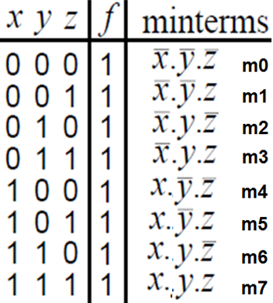
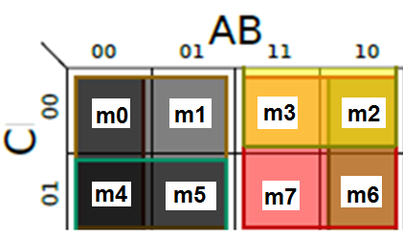
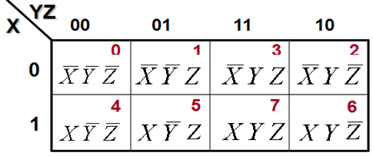

Minterm
A Boolean expression can be written as sum of minterms, of the row having 1 value
Minterm corresponds to a product term contain all variables (in either complement or uncomplemented form)
So x . y . z is a minterm but y . z is not
Note variables in a minterm are ANDed
together (conjunction)

Slide 31

Minterm
One minterm exists for each row of truth table and denoted as m0, m1,m2… ….. m2^{n} - 1
Total m2^{n} – 1 minterms are there for n variable truth table/function
A Boolean function formed by ORing each minterms for which f is 1(TRUE)
Sum of Products (SOP)
Any Boolean function can be expressed as
ORing of its minterms, for which function is 1 (True), expressing Boolean function in this form is said to be in Sum of Products (SOP) form, here all variables present in each term
• Boolean function can also be expressed as the ORing of AND terms (not necessarily minterms) is also said to be in Sum of Products (SOP) form, e.g.,
Canonical form
F = x + y.z
Standard form

Slide 32
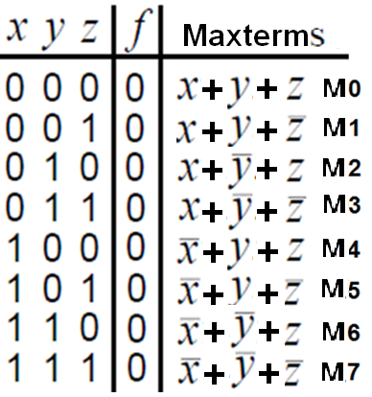
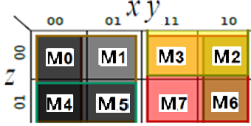
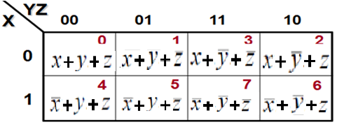

Maxterms
A Boolean expression can be written as Product of maxterms, of the row having ‘0’ value
Maxterm corresponds to a sum term contains all variables (in either complement or uncomplemented form)
So x + y + z is a maxterm but y + z is not

Slide 33

Maxterms
One Maxterm exists for each row of truth table as M0, M1 ………. M2^{n} - 1
Total M2^{n} – 1 maxterms are there for n variable truth table/function
A Boolean function formed by ANDing each maxterms for which f is 0.
Let a Boolean expression as, min term only
Applying De Morgan (and complementing) gives
max term only

Slide 34

Products of Sum (POS)
Any Boolean function can be expressed as
ANDing of its Maxterms, for which function is 0 (False), expressing Boolean function in this form is said to be in Products of Sum (SOP) form, where all variables present in each term
Boolean function can also be expressed as the ANDing of ORed terms (not necessarily Maxterms) is also said to be in Products of Sum (SOP) form, e.g.,
f = (x + y).(x + z)
Canonical form
Standard form

Slide 35

Conversion of SOP from standard to canonical form
Expand non-canonical terms by inserting equivalent of 1 in each missing variable x: (x + x’) = 1
Remove duplicate minterms
f₁(a,b,c) = a’b’c + bc’ + ac’ = a’b’c + (a+a’)bc’ + a(b+b’)c’ = a’b’c + abc’ + a’bc’ + abc’ + ab’c’ = a’b’c + abc’ + a’bc + ab’c’
Conversion of POS from standard to canonical form
Expand noncanonical terms by adding 0 in terms of missing variables (e.g., xx’ = 0) and using the distributive law
Remove duplicate maxterms
f₁(a,b,c) = (a+b+c)•(b’+c’)•(a’+c’) = (a+b+c)•(aa’+b’+c’)•(a’+bb’+c’) = (a+b+c)•(a+b’+c’)•(a’+b’+c’)• (a’+b+c’)•(a’+b’+c’) = (a+b+c)•(a+b’+c’)•(a’+b’+c’)•(a’+b+c’)

Slide 36
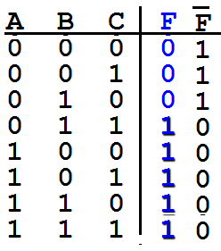
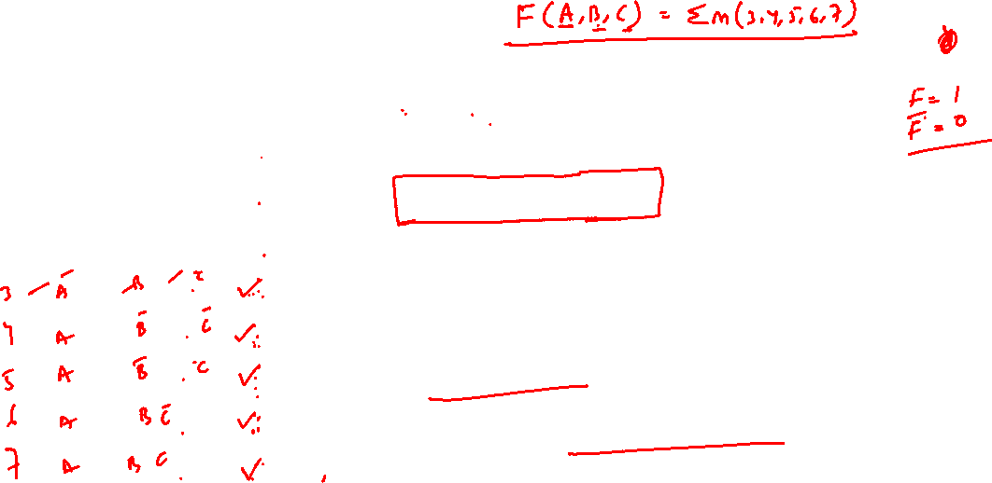
SOP Expressions
Sample truth table
F = A' B C + A B' C' + A B' C + A B C' + A B C
= ∑ m(3,4,5,6,7)
Shorthand notation of minterm
F' = A' B' C' + A' B' C + A' B C'
= ∑ m(0,1,2)
Shorthand notation of minterm

Slide 37

POS Expressions
Sample truth table
F = (A + B +C) (A + B + C')
• (A + B' + C)
= Π M(0,1,2)
Shorthand notation of Maxterm
F' = (A + B' +C') (A' + B + C)
• (A' + B + C') (A' + B' + C)
• (A' + B' + C')
= Π M(3,4,5,6,7)
Shorthand notation of Maxterm

Slide 38
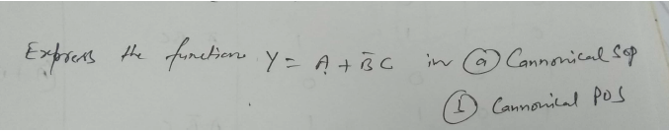

Example
Each individual term in the SOP form is called as minterm.
Each individual term in the POS form is called as maxterm.
Each maxterm is the complement of the corresponding minterm.

Slide 39
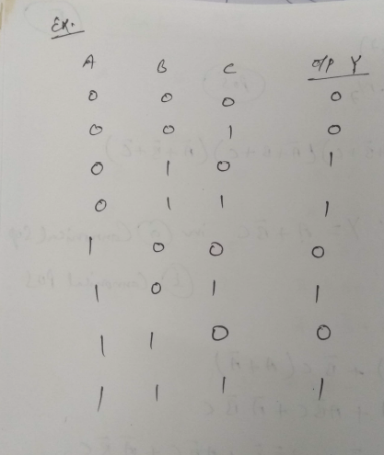

Example

Slide 40
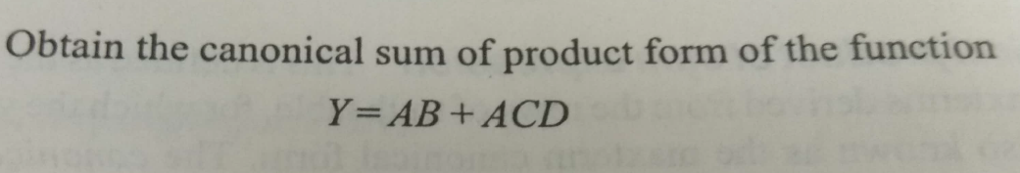
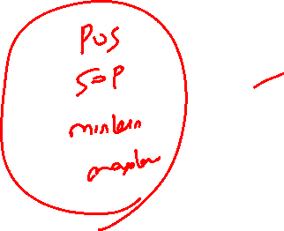
Example

Slide 41
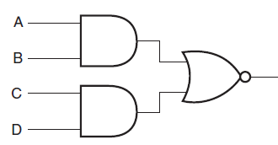
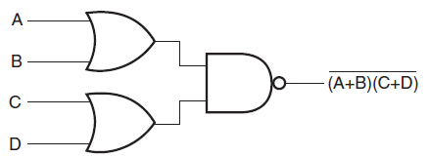

Realization of Boolean Function Using Gates
Consider a Boolean function f= (AB+CD), Implement this function
Consider a Boolean function f= (A+B)(C+D), Implement this function

Slide 42

Realization of Boolean Function Using Gates
Logic Circuits ≡ Boolean Expressions
All logic circuits are equivalent to Boolean expressions and any boolean expression can be rendered as a logic circuit.
AND-OR logic circuits are equivalent to sum-of-products form.
Consider the following circuits:
A
Y=AB’+B’C
ABC
B
C
A
B
Y
AB’C
Y
C
Y= ABC+AB’C+A’B
A’B

Slide 43
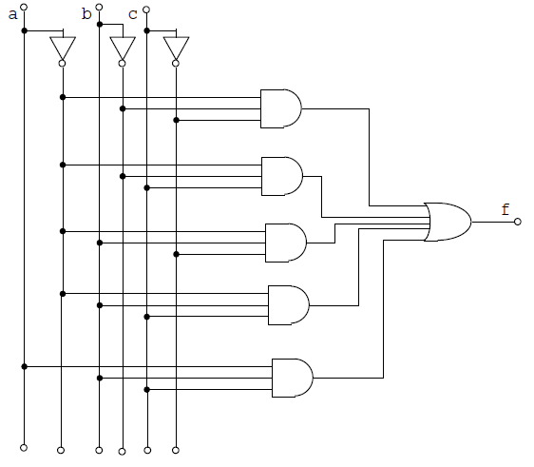
Realization of Boolean Function Using Gates
Similarly Consider a Boolean function
Realization of this Boolean function is shown in figure below
Total no of gates
NOT Gate 3
AND Gate 5
OR Gate 1
--------------------
9 Gates

Slide 44
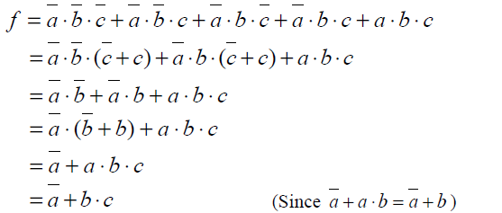
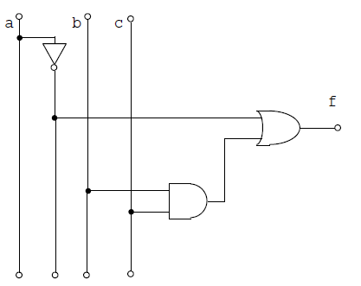
Realization of Boolean Function Using Gates
If we use of Boolean algebra in getting the minimal Boolean function as given below:
Total no of gates
NOT Gate 1
AND Gate 1
OR Gate 1
Total : 3 Gates
This reduced Boolean function need to have only three gates
It is clear form the above discussion that the minimized Boolean function needs
less number of gates for the realization.
This signifies the importance of Boolean algebra.
The minimized functions
help in reducing the number of gates
increase the reliability of the circuit and
increase speed of operation

Slide 45
Advantages for Logic Minimization
Reduce complexity of the gate level implementation
• reduce number of literals (gate inputs)
• reduce number of gates
• reduce number of levels of gates
fewer inputs implies faster gates in some technologies
fan-ins (number of gate inputs) are limited in some technologies
fewer levels of gates implies reduced signal propagation delays
minimum delay configuration typically requires more gates
number of gates (or gate packages) influences manufacturing costs

Slide 46

Combinational Circuit
There are two general categories of Digital Circuits
(i). combinational circuit
(ii) sequential circuit
In a combinational circuit, the input values explicitly determine the output
In a sequential circuit, the output is a function of the input values as well as the existing state of the circuit
As with gates, we can describe the operations of entire circuits using three notations
truth tables
Boolean expressions
logic diagrams

Slide 47
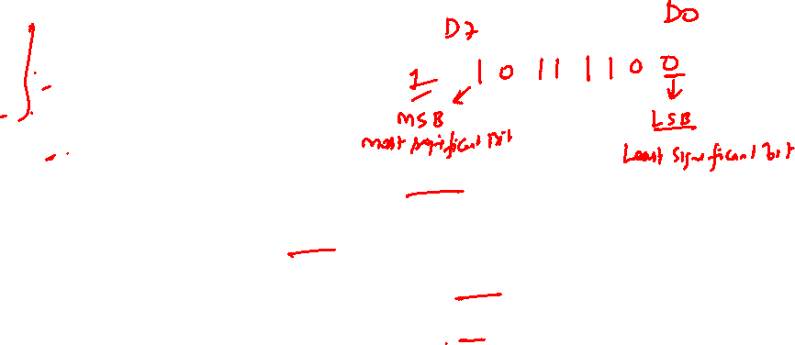
BINARY ADDER
The circuits used to perform arithmetic operations are constructed using combinatorial logic.
Digital system can perform various operation over binary data
The most basic and most used arithmetic operation is the addition of two binary digits.
This simple addition consists of four possible elementary operations:
0 + 0 = 0;
0 + 1 = 1;
1 + 0 = 1;
And 1 + 1 = 10 (that is binary 2₂).
The first three operations produce a sum of one digit,
but last operation, when both augend and addend bits are equal to 1, then the binary sum consists of two digits.
The higher significant bit of this result is called a ‘Carry’ or C.
Whereas least significant bit in all case is called ‘SUM’ or S

Slide 48
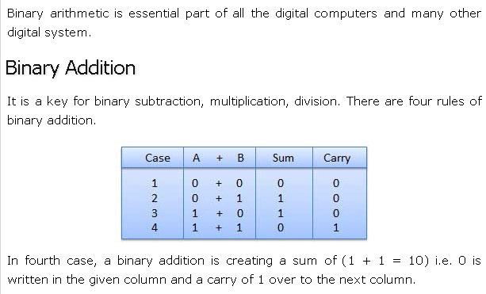
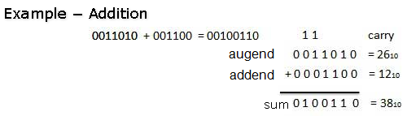
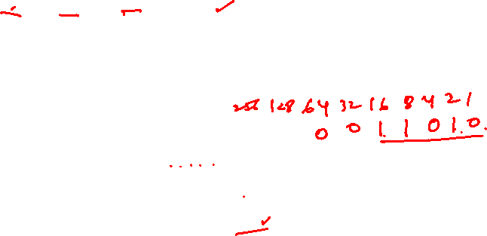
BINARY Addition

Slide 49
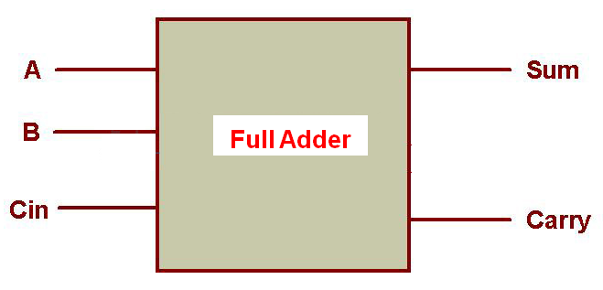
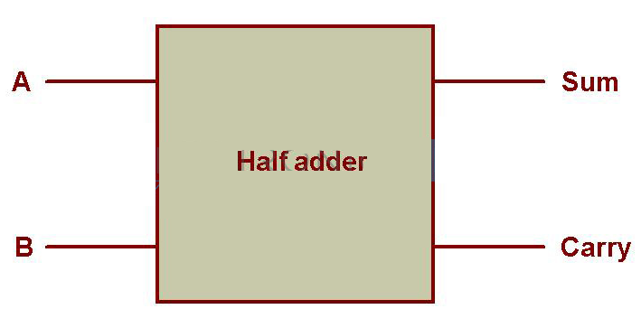

BINARY ADDER
An ‘ADDER’ is a combinational circuit that performs simple binary addition.
To perform complete one bit binary addition ( See column 5 & 6 at HSB in pre.example)
An ‘ADDER’ requires
Three inputs, (two for augend and addend & one for carry) and
Two outputs, (for sum and carry),.
Adder, which performs complete one bit binary addition is known as ‘Full Adder’
But, An partial one bit binary addition can be performed by ignoring carry bit.
This partial one bit addition (See column 1, 2, 3 & 4 at LSB in example)
Two inputs, two for augend and addend and
Two outputs, for sum and carry,.
Adder, which performs partial one bit ‘partial’ binary addition is known as ‘Half Adder’

Slide 50
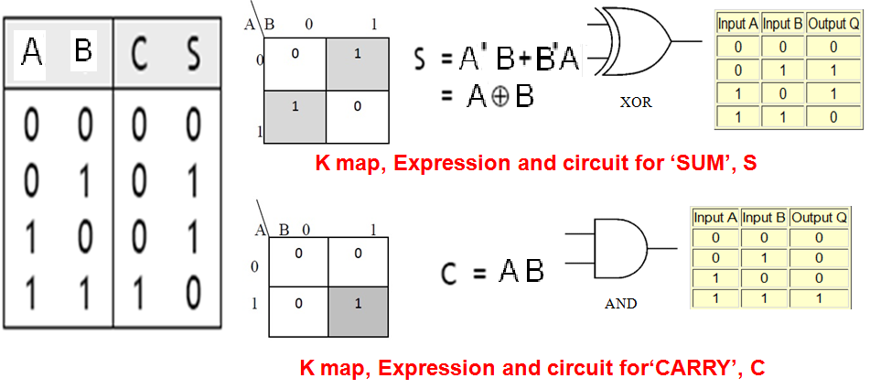
Design of Binary ADDER: Half Adder
An Half adder performs partial one bit binary addition for two input bit
It must have two inputs (augend and addend) and two outputs (sum and carry).
This circuit called ‘Half Adder’ as it can performs only partial addition operation not complete one bit addition, as it ignores ‘input carry’.
The K map for S (SUM) and C (Carry) and resulting expression A B and A.B

Slide 51
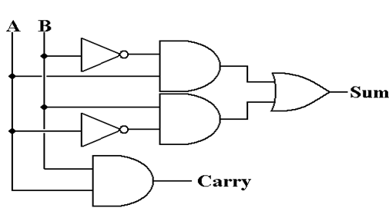




Half Adder
If A and B are binary inputs to the half adder, then
the logic function to calculate sum S is Ex -OR of A and B and
logic function to calculate carry C is AND of A and B.
Combining these two, the logical circuit to implement the combinational circuit of Half Adder is shown below.

Slide 52

Half Adder using NAND Gates
As we know that NAND and NOR are called universal gates as any logic system can be implemented using these two
The half adder circuit can also be implemented using them.
We know the NAND only circuit of Ex-OR gate and AND gate. Same is used her.e
Figure shows the Half Adder circuit using NAND gates only.
Five NAND gates are required in order to design a half adder. The circuit to realize half adder using NAND gates is shown below.

Slide 53

Half Adder using only NOR Gates
Limitations of Half Adder
The reason these simple binary adders are called Half Adders is that there is no scope for them to add the carry bit from previous bit.
This is a major limitation of half adders when used as binary adders especially in real time scenarios which involves addition of multiple bits.
To overcome this limitation, full adders are developed

Slide 54
Full Adder
Full adder is a digital circuit used to perform complete one bit binary addition
It is used to calculate the binary sum of three input binary bits, which is the main difference between this and half adder.
Full adders are complex and difficult to implement when compared to half adders.
Two of the three bits are same as before: A the augend bit and B the addend bit
The additional third bit is carry bit from the previous stage and is called Carry, in generally represented by C_{IN}.
It calculates the sum of three bits along with the carry.
The output carry is called Carry – out and is represented by C_{OUT}.

Slide 55



Design of Binary ADDER: Full Adder
The truth table for full adder
K – Map for Sum S
Expression for Sum, S
S = A’B’C+A’BC’+AB’C’+ABC
K – Map For Carry – out C_{OUT}
Expression for C_{OUT}
C_{OUT} = AB + AC_{IN} + BC_{IN}

Slide 56

Full Adder Circuit
In order to implement a combinational circuit for Full Adder, it is clear from the equations that we need
For Sum
4 three input AND gates and
1 four input OR gate and
The logic circuit for full adder is shown below.
For Carry-out.
3 two input AND gates and
1 three input OR gate

Slide 57
Design of Binary ADDER: Full Adder
We know the equations for S and C_{OUT} from earlier calculations as
S = A’B’C_{in}+A’BC’_{in}+AB’C’_{in}+ABC_{in}
C_{out} = AB + AC_{IN} + BC_{IN}
We can rewrite the equation for sum as follows.
S = A’B’C_{in}+A’BC’_{in}+AB’C’_{in}+ABC_{in}
= C_{in}(A’B’ + AB) + C’_{in} (A’B + AB’ )
= C_{in}(A • B) + C’_{in} (A B )
= C_{in} (A B)’ + C’_{in} (A B )
Therefore S = C_{IN} (A B)
C_{out} is simplified as
C_{OUT} = A B + AC_{IN} + BC_{IN}.
= A B + AC_{IN} + ABC_{IN} + A’BC_{IN} (as A’+A =1)
= A B + ABC_{IN} + AC_{IN} + A’BC_{IN}
= A B + AC_{IN} + A’BC_{IN} (as 1+C_{IN} = 1)
= A B + AC_{IN} (B+B’) + A’BC_{IN} (as B+B’ =1)
= A B + ABC_{IN} + AB’C_{IN} + A’BC_{IN}
= A B + AB’C_{IN} + A’BC_{IN} (as 1+C_{IN} = 1)
= A B + C_{IN} (A B)
K – Map for Sum S
⊕
Expression for Sum, S
S = A’B’C_{in} +A’BC’_{in}+AB’ C’_{in}+ABC_{in}
⊕
⊕
⊕
⊕
K – Map For Carry – out C_{OUT}
Expression for C_{OUT}
C_{OUT} = AB + AC_{IN} + BC_{IN}
⊕

Slide 58


Slide 59


Implementation of Full Adder using Two Half Adder
and one OR Gate

Slide 60


Implementation of Full Adder using Two Half Adders
A full adder can be formed by logically connecting two half adders.
the full adder is simply two half adders joined by an OR Gate.
The block diagram shows the implementation of a full adder using two half adders.
The first half adder will be used to add A and B to produce a partial Sum.
The second half adder logic can be used to add C_{IN} to the Sum produced by the first half adder to get the final S output.
If any of the half adder logic produces a carry, there will be an output carry.
Thus, C_{OUT} will be OR function of the half-adder Carry outputs (of Both HA).

Slide 61
Half Subtractor
The half subtractor is a combinational circuit which is used to perform subtraction of two bits.
It has two inputs, the minuend Ai and subtrahend Bi and two outputs the difference D and borrow out C_{out} .
The borrow out signal is set when the subtractor needs to borrow from the next digit in a multi-digit subtraction.
That is, Barrow bit C_{out} is 1 when Ai <Bi . Since Ai and Bi are bits, C_{out} = 1 if and only if Ai =0 and Bi=1.
An important point worth mentioning is that the half subtractor diagram aside implements Ai – Bi and not Bi – Ai since C_{out} on the diagram is given by
C_{out} = A’i Bi
This is an important distinction to make since subtraction itself is not commutative, but the difference bit D is calculated using an XOR gate which is commutative.

Slide 62


Half Subtractor
A_{i}
B_{i}
D
C
1
0 0 0 0 A’B’
0 1 1 1 A’B
1 0 1 0 A B’
1 1 0 0 A B
D =(A_{i} B_{i})
⊕
C₁=(A’_{i} B_{i})
A
D
D =(A_{i} B_{i})
⊕
B
C₁
C₁=(A’_{i} B_{i})

Slide 63
Full Subtractor
The full subtractor is a combinational circuit which is used to perform subtraction of three input bits: the minuend Ai, subtrahend Bi, and borrow in C_{in} .
The full subtractor generates two output bits: the difference D and borrow out C_{out}.
C_{in} is set when the previous digit borrowed from A_{i} .
Thus, C_{in} is also subtracted from Ai as well as the subtrahend Bi .
Or in symbols: Ai – Bi – C_{in}
Like the half subtractor, the full subtractor generates a borrow out when it needs to borrow from the next digit.
Since we are subtracting Bi and C_{in} by Ai, a borrow out needs to be generated when Ai < Bi +C_{in}.
When a borrow out is generated, 2 is added in the current digit. (This is similar to the subtraction algorithm in decimal. Instead of adding 2, we add 10 when we borrow.).
Therefore, D = Ai – Bi – C_{in} + 2 C_{out}

Slide 64

Full Subtractor

Slide 65

Half Subtractor Using Nand only Gate

Slide 66
Full Subtractor using Two Half Adder and a OR Gate
borrow out D = C_{i} (A_{i} B_{i})
⊕
⊕
borrow out C_{i+1}=A_{i}’B_{i}C_{i}’+A_{i}’B_{i}’C_{i}
+C_{i}A’_{i}B_{i}+A_{i}B_{i}C_{i}
=C_{i}(A_{i}’B_{i}’+A_{i}B_{i})
+A’_{i}B_{i}(C_{i}+C_{i}’)
=C_{i}(A_{i} B_{i})’+A’_{i}B_{i}
⊕
half subtractor
half subtractor

Slide 67

Mode Controlled Full Adder/Subtractor

Slide 68
Controlled Full Adder/Subtractor
C
i
A
D
i
i
B
i
i+1
C
E
E = 0: Full adder
E = 1: Full subtractor

Slide 69
N-Bit Adder/Subtractor
4-bit Subtractor: E = 0
For
E = 0: 4-bit adder
E = 1: 4-bit subtractor

Slide 70
4-bit Subtractor: E = 1
+1
Add A to !B (one’s complement) plus 1
That is, add A to two’s complement of B; D = A - B

Slide 71
Boolean Algebra
Boolean algebra is a mathematical system for the manipulation of variables that can have one of two values.
In formal logic, these values are “true” and “false.”
In digital systems, these values are “on” and “off,” 1 and 0, or “high” and “low.”
Boolean expressions are created by performing operations on Boolean variables.
Common Boolean operators include AND, OR, and NOT.
The electronic circuit which performs/implement these Boolean logic operation are known as LOGIC GATE.

Slide 72
Postulates of Boolean Algebra
A Boolean function has:
At least one Boolean variable,
At least one Boolean operator, and
At least one input from the set {0,1}.
It produces an output that is also a member of the set {0,1}.

Slide 73
Postulates of Boolean Algebra
Boolean Algebra is an algebraic structure defined on a set of elements B together with two binary operators ‘+’ and ‘.’ provided the following (Huntington) postulates are satisfied
Postulate 1: Closure Property: For every A, B ϵ S
(i) D = A + B and D ϵ S: This is the closure property for OR operation.
(ii) G = A.B and G ϵ S: This is the closure property for AND operation.
Postulate 2: Commutative Law: If A and B ϵ S then
(i) A + B = B + A
(ii) A . B = B . A

Slide 74
Postulates of Boolean Algebra
Postulate 3: Identity Element:
The identity element for OR operator is 0, if A ϵ S and 0 ϵ S
then A + 0 = 0 + A = A : 0 is known as addition identity.
(ii) The identity element for AND operator is 1, if A ϵ S and 1 ϵ S
then A . 1 = 1 . A = A : 1 is known as multiplication identity.
Postulate 4: Distributive Law: If A, B, C ϵ S then
(i) A . (B + C) = A . B + A . C
(ii) A + B . C = (A + B) . (A + C)
Postulate 5: Complementing Law: If A ϵ S, there exist an element (known as complement of a) which belong to S ( ϵ S ) such that
A+ = 1
(ii) A . = 0
Postulate 6 : There are at least two elements A , B Î S such that A ≠ B .

Slide 75
Boolean algebra Vs ordinary algebra
Boolean algebra differs with ordinary algebra on the following points:
The associative law doesn’t include in Huntington postulates but holds for boolean algebra
2. The distributive law A + B . C = (A + B) . (A + C) does not hold in ordinary
algebra.
3. Complementing law does not hold in ordinary algebra, i.e., there is no
equivalent of the unary operator (NOT operation) in ordinary algebra.
4. Boolean algebra does not have the additive inverse and multiplicative
inverse due to which no subtraction or division operations exist.
5. Boolean algebra has only finite set of elements where as the ordinary
algebra deals with real numbers which constitute a set with infinite number of
elements.
Switching algebra, a special class of Boolean algebra however, deals with two valued elements.
In Boolean algebra the elements should have the values 0 and 1 only.

Slide 76
Two – Valued Boolean Algebra:
The postulates of special class of Boolean algebra known as two valued Boolean algebra or switching algebra, if a set of two elements 0 & 1 are assumed.
The postulates are summarized below: This first group is rather intuitive:
These postulates are also given in the general form as:

Slide 77
Theorems of Boolean Algebra
The following are the general theorems or rules of Boolean algebra:
This theorem 3 (a) and (b) is also called as absorption theorem.

Slide 78
Theorems of Boolean Algebra
Corollary of the absorption theorem is given as follows:
This theorem is also called second absorption theorem.
Corollary of theorem 5 is given as

Slide 79
Theorems of Boolean Algebra

Slide 80
DeMorgan’s Theorem
(a) Complement of product of two or more Boolean numbers is equivalent to sum of complement of those Boolean numbers
A NAND gate is equivalent to an inversion followed by an OR
(b) Complement of sum of two or more Boolean numbers is equivalent to product of complement of those Boolean numbers
A NOR gate is equivalent to an inversion followed by and AND

Slide 81
DeMorgan Truth Table
A | B
0 | 0 | 1 | 1 | 1 | 1
0 | 1 | 1 | 1 | 0 | 0
1 | 0 | 1 | 1 | 0 | 0
1 | 1 | 0 | 0 | 0 | 0
NAND
NOR
Duality Principle
According to this principle
“It states that every algebraic expression deducible from the postulates of Boolean algebra remain valid if the operators and the identity elements are interchanged”
So, the postulates or theorems of:-
Boolean algebra are given for one type of operation may be converted to other type of operation (i.e. OR to AND or vice versa) just by interchanging 0 with 1 and ‘+’ with ‘.’
This principle ensures that if a theorem is proved using the postulates of Boolean algebra then dual of this theorem automatically holds and need not to be proved separately.

Slide 82
Boolean Algebra

Slide 83
Boolean Algebra (Cont.)

Slide 84
Boolean Algebra (Cont.)

Slide 85
Simplifying Algebraic Expressions
Algebraic manipulation
We can use Boolean identities to simplify the function:
as follows:

Slide 86
Postulates and theorems of Boolean Algebra

Slide 87
Operator Precedence
The Operator Precedence for evaluating Boolean expression is
Parentheses
NOT
AND
OR
So the expression inside the parentheses must be evaluated first before all other operations. The next operation precedence is the complement operator.
Then follows the AND and finally the OR operation is considered
For example in the truth table for Demorgon’s theorem.
LHS expression is (x+y)’, therefore the expression inside the parentheses is evaluated first and the result then complemented.
The right side of the expression is x’y’. Therefore the complement of x and complement of y both are evaluated first and the result is then ANDed

Slide 88
Boolean Algebra (Cont.)

Slide 92
Simplifying Algebraic Expressions
Logic Minimization
Two methods of simplifying algebraic expressions are the map method and tabular method.
The map method is used for functions up to six variable.
The map method is also known as the Karnaugh map or k-map Method.
To manipulate functions of many variables , the tabular method is used which is also known as Quine-McCluskey method.

Slide 93
Logic Minimization
Minimization is the process of reducing a complex logic expression or equation into a simpler form with fewer terms by removing redundancies and terms having no effect on the output.
This is like simplifying and reducing complex algebraic expressions by collecting and combining like terms.
As in algebraic reduction, rules must be followed that guarantee the value of the expression is not changed by the simplification.
Any Boolean function can be implemented directly using combinational logic (gates).
However, simplifying the Boolean function will enable the number of gates required to be reduced.
Available Minimization Techniques include:
– Algebraic manipulation (see in some previous slides examples)
– Karnaugh (K) mapping (a visual approach)
– Tabular approaches (usually implemented by computer, e.g., Quine-
McCluskey method)
K mapping is the preferred technique for up to about 4-5 variables

Slide 94
Product and Sum of Product (SOP) Term
A Product term is the entity of the binary expression, which associates multiple literals (variable or its complement) together in single item/entity using Product operator (.)
Exp.: A' B , B' C‘ , A B' C etc.
SOP Term: The Sum expression formed by combining product terms using sum operators are known as sum of product (SOP) terms
Exp.: A' B + B' C' + A B' C
SUM and product of sum (POS)Term
A SUM term is the entity of the binary expression, which associates multiple literals (variable or its complement) together in single item/entity using SUM operator (+)
Exp.: A‘ + B , B‘ + C‘ , A + B' + C etc.
POS Term: The Product expression formed by combining Sum terms using Product operators are known as product of sum (POS) terms
Exp.: (A' + B). (B' + C‘) + (A +B'+ C)

Slide 95
Standard Forms
A Boolean function F( ) can be expressed in simplified form in which the term of the function does not contains all variables (in either complement or uncomplemented form, literals). This form of the Boolean function is known as ‘Standard Form’
F = A' B + B' C' + A B' C
F = (A + B) (A + B + C’) • (A + B‘ )
Canonical Form
Any Boolean function F( ) can be expressed as a unique sum of minterms* and a unique product of maxterms**) (under a fixed variable ordering).
Every term of such function contains all variables in either complement or uncomplemented form. This form of the Boolean function is known as ‘Canonical Form’
In other words, every function F() has two canonical forms:
Canonical Sum-Of-Products SOP (sum of minterms)
Canonical Product-Of-Sums POS (poduct of maxterms)
F = A' B C + A B' C' + A B' C + A B C' + A B C
F = (A + B +C) (A + B + C‘) • (A + B' + C)
*Minterm:A Product term containing all variables in complement or uncomplemented form.
**Maxterm: A Sum term containing all variables in complement or uncomplemented form.

Slide 96
Minterm
A Boolean expression can be written as sum of minterms, of the row having 1 value
Minterm corresponds to a product term contain all variables (in either complement or uncomplemented form)
So x . y . z is a minterm but y . z is not
Note variables in a minterm are ANDed
together (conjunction)

Slide 97
Minterm
One minterm exists for each row of truth table and denoted as m0, m1,m2… ….. m2^{n} - 1
Total m2^{n} – 1 minterms are there for n variable truth table/function
A Boolean function formed by ORing each minterms for which f is 1(TRUE)
Sum of Products (SOP)
Any Boolean function can be expressed as
ORing of its minterms, for which function is 1 (True), expressing Boolean function in this form is said to be in Sum of Products (SOP) form, here all variables present in each term
• Boolean function can also be expressed as the ORing of AND terms (not necessarily minterms) is also said to be in Sum of Products (SOP) form, e.g.,
Canonical form
F = x + y.z
Standard form

Slide 99
Maxterms
A Boolean expression can be written as Product of maxterms, of the row having ‘0’ value
Maxterm corresponds to a sum term contains all variables (in either complement or uncomplemented form)
So x + y + z is a maxterm but y + z is not

Slide 100
Maxterms
One Maxterm exists for each row of truth table as M0, M1 ………. M2^{n} - 1
Total M2^{n} – 1 maxterms are there for n variable truth table/function
A Boolean function formed by ANDing each maxterms for which f is 0.
Let a Boolean expression as, min term only
Applying De Morgan (and complementing) gives
max term only

Slide 101
Products of Sum (POS)
Any Boolean function can be expressed as
ANDing of its Maxterms, for which function is 0 (False), expressing Boolean function in this form is said to be in Products of Sum (SOP) form, where all variables present in each term
Boolean function can also be expressed as the ANDing of ORed terms (not necessarily Maxterms) is also said to be in Products of Sum (SOP) form, e.g.,
f = (x + y).(x + z)
Canonical form
Standard form

Slide 102
Conversion of SOP from standard to canonical form
Expand non-canonical terms by inserting equivalent of 1 in each missing variable x: (x + x’) = 1
Remove duplicate minterms
f₁(a,b,c) = a’b’c + bc’ + ac’ = a’b’c + (a+a’)bc’ + a(b+b’)c’ = a’b’c + abc’ + a’bc’ + abc’ + ab’c’ = a’b’c + abc’ + a’bc + ab’c’
Conversion of POS from standard to canonical form
Expand noncanonical terms by adding 0 in terms of missing variables (e.g., xx’ = 0) and using the distributive law
Remove duplicate maxterms
f₁(a,b,c) = (a+b+c)•(b’+c’)•(a’+c’) = (a+b+c)•(aa’+b’+c’)•(a’+bb’+c’) = (a+b+c)•(a+b’+c’)•(a’+b’+c’)• (a’+b+c’)•(a’+b’+c’) = (a+b+c)•(a+b’+c’)•(a’+b’+c’)•(a’+b+c’)

Slide 103
SOP Expressions
Sample truth table
F = A' B C + A B' C' + A B' C + A B C' + A B C
= ∑ m(3,4,5,6,7)
Shorthand notation of minterm
F' = A' B' C' + A' B' C + A' B C'
= ∑ m(0,1,2)
Shorthand notation of minterm

Slide 104
POS Expressions
Sample truth table
F = (A + B +C) (A + B + C')
• (A + B' + C)
= Π M(0,1,2)
Shorthand notation of Maxterm
F' = (A + B' +C') (A' + B + C)
• (A' + B + C') (A' + B' + C)
• (A' + B' + C')
= Π M(3,4,5,6,7)
Shorthand notation of Maxterm

Slide 105
Example
Each individual term in the SOP form is called as minterm.
Each individual term in the POS form is called as maxterm.
Each maxterm is the complement of the corresponding minterm.

Slide 106
Example

Slide 107
Example

Slide 108
Conversion Between Canonical Forms
Replace ∑ with ∏ (or vice versa) and replace those j’s that appeared in the original form with those that do not.
Example: f₁(a,b,c) = a’b’c + a’bc’ + ab’c’ + abc’ = m₁ + m₂ + m₄ + m₆ = ∑(1,2,4,6) = ∏(0,3,5,7) = (a+b+c)•(a+b’+c’)•(a’+b+c’)•(a’+b’+c’)
Complementary relations between minterms & Maxterms
F(A,B,C) = ∑ m(3,4,5,6,7) = Π M(0,1,2)
SOP POS
F'(A,B,C) = ∑ m(0,1,2) = Π M(3,4,5,6,7)

Slide 109


Don’t care terms
Don’t care terms
Outputs associated with inputs that can be ignored
These inputs CANNOT happen in a good design
Assign logic values to these outputs to simplify circuits
Example:
Binary Coded Decimal (BCD)

Slide 110
Don’t Care & Canonical Forms
Representing “d” in BCD
d= don’t care term
F(A,B,C,D) = m₁ + m₃ + m₅ + m₇ + m₉
+ d₁₁ + d₁₃ + d₁₅
= ∑[m(1,3,5,7,9) + d(11,13,15) ]
F(A,B,C,D) = M₀ • M₂ • M₄ • M₆ • M₈ • D₁₀ • D₁₂ • D₁₄
= Π[M(0,2,4,6,8) • D(10,12,14) ]

Slide 111
Realization of Boolean Function Using Gates
Consider a Boolean function f= (AB+CD), Implement this function
Consider a Boolean function f= (A+B)(C+D), Implement this function

Slide 112
Realization of Boolean Function Using Gates
Logic Circuits ≡ Boolean Expressions
All logic circuits are equivalent to Boolean expressions and any boolean expression can be rendered as a logic circuit.
AND-OR logic circuits are equivalent to sum-of-products form.
Consider the following circuits:
A
Y=AB’+B’C
ABC
B
C
A
B
Y
AB’C
Y
C
Y= ABC+AB’C+A’B
A’B

Slide 113

Realization of Boolean Function Using Gates
Similarly Consider a Boolean function
Realization of this Boolean function is shown in figure below
Total no of gates
NOT Gate 3
AND Gate 5
OR Gate 1
--------------------
9 Gates

Slide 114
Realization of Boolean Function Using Gates
If we use of Boolean algebra in getting the minimal Boolean function as given below:
Total no of gates
NOT Gate 1
AND Gate 1
OR Gate 1
Total : 3 Gates
This reduced Boolean function need to have only three gates
It is clear form the above discussion that the minimized Boolean function needs
less number of gates for the realization.
This signifies the importance of Boolean algebra.
The minimized functions
help in reducing the number of gates
increase the reliability of the circuit and
increase speed of operation

Slide 115
Advantages for Logic Minimization
Reduce complexity of the gate level implementation
• reduce number of literals (gate inputs)
• reduce number of gates
• reduce number of levels of gates
fewer inputs implies faster gates in some technologies
fan-ins (number of gate inputs) are limited in some technologies
fewer levels of gates implies reduced signal propagation delays
minimum delay configuration typically requires more gates
number of gates (or gate packages) influences manufacturing costs

Slide 116
Combinational Circuit
There are two general categories of Digital Circuits
(i). combinational circuit
(ii) sequential circuit
In a combinational circuit, the input values explicitly determine the output
In a sequential circuit, the output is a function of the input values as well as the existing state of the circuit
As with gates, we can describe the operations of entire circuits using three notations
truth tables
Boolean expressions
logic diagrams

Slide 117


Slide 118
BINARY ADDER
The circuits used to perform arithmetic operations are constructed using combinatorial logic.
Digital system can perform various operation over binary data
The most basic and most used arithmetic operation is the addition of two binary digits.
This simple addition consists of four possible elementary operations:
0 + 0 = 0;
0 + 1 = 1;
1 + 0 = 1;
And 1 + 1 = 10 (that is binary 2₂).
The first three operations produce a sum of one digit,
but last operation, when both augend and addend bits are equal to 1, then the binary sum consists of two digits.
The higher significant bit of this result is called a ‘Carry’ or C.
Whereas least significant bit in all case is called ‘SUM’ or S

Slide 119
BINARY Addition

Slide 120

BINARY ADDER
An ‘ADDER’ is a combinational circuit that performs simple binary addition.
To perform complete one bit binary addition ( See column 5 & 6 at HSB in pre.example)
An ‘ADDER’ requires
Three inputs, (two for augend and addend & one for carry) and
Two outputs, (for sum and carry),.
Adder, which performs complete one bit binary addition is known as ‘Full Adder’
But, An partial one bit binary addition can be performed by ignoring carry bit.
This partial one bit addition (See column 1, 2, 3 & 4 at LSB in example)
Two inputs, two for augend and addend and
Two outputs, for sum and carry,.
Adder, which performs partial one bit ‘partial’ binary addition is known as ‘Half Adder’

Slide 121

Design of Binary ADDER: Half Adder
An Half adder performs partial one bit binary addition for two input bit
It must have two inputs (augend and addend) and two outputs (sum and carry).
This circuit called ‘Half Adder’ as it can performs only partial addition operation not complete one bit addition, as it ignores ‘input carry’.
The K map for S (SUM) and C (Carry) and resulting expression A B and A.B

Slide 122

Half Adder
If A and B are binary inputs to the half adder, then
the logic function to calculate sum S is Ex -OR of A and B and
logic function to calculate carry C is AND of A and B.
Combining these two, the logical circuit to implement the combinational circuit of Half Adder is shown below.

Slide 123

Half Adder using NAND Gates
As we know that NAND and NOR are called universal gates as any logic system can be implemented using these two
The half adder circuit can also be implemented using them.
We know the NAND only circuit of Ex-OR gate and AND gate. Same is used her.e
Figure shows the Half Adder circuit using NAND gates only.
Five NAND gates are required in order to design a half adder. The circuit to realize half adder using NAND gates is shown below.

Slide 124

Half Adder using only NOR Gates
Limitations of Half Adder
The reason these simple binary adders are called Half Adders is that there is no scope for them to add the carry bit from previous bit.
This is a major limitation of half adders when used as binary adders especially in real time scenarios which involves addition of multiple bits.
To overcome this limitation, full adders are developed

Slide 125

Full Adder
Full adder is a digital circuit used to perform complete one bit binary addition
It is used to calculate the binary sum of three input binary bits, which is the main difference between this and half adder.
Full adders are complex and difficult to implement when compared to half adders.
Two of the three bits are same as before: A the augend bit and B the addend bit
The additional third bit is carry bit from the previous stage and is called Carry, in generally represented by C_{IN}.
It calculates the sum of three bits along with the carry.
The output carry is called Carry – out and is represented by C_{OUT}.

Slide 126

Design of Binary ADDER: Full Adder
The truth table for full adder
K – Map for Sum S
Expression for Sum, S
S = A’B’C+A’BC’+AB’C’+ABC
K – Map For Carry – out C_{OUT}
Expression for C_{OUT}
C_{OUT} = AB + AC_{IN} + BC_{IN}

Slide 127

Full Adder Circuit
In order to implement a combinational circuit for Full Adder, it is clear from the equations that we need
For Sum
4 three input AND gates and
1 four input OR gate and
The logic circuit for full adder is shown below.
For Carry-out.
3 two input AND gates and
1 three input OR gate

Slide 128


Slide 129
Implementation of Full Adder using Two Half Adder
and one OR Gate

Slide 130

Implementation of Full Adder using Two Half Adders
A full adder can be formed by logically connecting two half adders.
the full adder is simply two half adders joined by an OR Gate.
The block diagram shows the implementation of a full adder using two half adders.
The first half adder will be used to add A and B to produce a partial Sum.
The second half adder logic can be used to add C_{IN} to the Sum produced by the first half adder to get the final S output.
If any of the half adder logic produces a carry, there will be an output carry.
Thus, C_{OUT} will be OR function of the half-adder Carry outputs (of Both HA).

Slide 131
Half Subtractor
The half subtractor is a combinational circuit which is used to perform subtraction of two bits.
It has two inputs, the minuend Ai and subtrahend Bi and two outputs the difference D and borrow out C_{out} .
The borrow out signal is set when the subtractor needs to borrow from the next digit in a multi-digit subtraction.
That is, Barrow bit C_{out} is 1 when Ai <Bi . Since Ai and Bi are bits, C_{out} = 1 if and only if Ai =0 and Bi=1.
An important point worth mentioning is that the half subtractor diagram aside implements Ai – Bi and not Bi – Ai since C_{out} on the diagram is given by
C_{out} = A’i Bi
This is an important distinction to make since subtraction itself is not commutative, but the difference bit D is calculated using an XOR gate which is commutative.

Slide 132

Half Subtractor
A_{i}
B_{i}
D
C
1
0 0 0 0 A’B’
0 1 1 1 A’B
1 0 1 0 A B’
1 1 0 0 A B
D =(A_{i} B_{i})
⊕
C₁=(A’_{i} B_{i})
A
D
D =(A_{i} B_{i})
⊕
B
C₁
C₁=(A’_{i} B_{i})

Slide 133

Full Subtractor
The full subtractor is a combinational circuit which is used to perform subtraction of three input bits: the minuend Ai, subtrahend Bi, and borrow in C_{in} .
The full subtractor generates two output bits: the difference D and borrow out C_{out}.
C_{in} is set when the previous digit borrowed from A_{i} .
Thus, C_{in} is also subtracted from Ai as well as the subtrahend Bi .
Or in symbols: Ai – Bi – C_{in}
Like the half subtractor, the full subtractor generates a borrow out when it needs to borrow from the next digit.
Since we are subtracting Bi and C_{in} by Ai, a borrow out needs to be generated when Ai < Bi +C_{in}.
When a borrow out is generated, 2 is added in the current digit. (This is similar to the subtraction algorithm in decimal. Instead of adding 2, we add 10 when we borrow.).
Therefore, D = Ai – Bi – C_{in} + 2 C_{out}

Slide 134

Full Subtractor

Slide 135
Half Subtractor Using Nand only Gate

Slide 136

Full Subtractor using Two Half Adder and a OR Gate
borrow out D = C_{i} (A_{i} B_{i})
⊕
⊕
borrow out C_{i+1}=A_{i}’B_{i}C_{i}’+A_{i}’B_{i}’C_{i}
+C_{i}A’_{i}B_{i}+A_{i}B_{i}C_{i}
=C_{i}(A_{i}’B_{i}’+A_{i}B_{i})
+A’_{i}B_{i}(C_{i}+C_{i}’)
=C_{i}(A_{i} B_{i})’+A’_{i}B_{i}
⊕
half subtractor
half subtractor

Slide 137

Mode Controlled Full Adder/Subtractor

Slide 138

Controlled Full Adder/Subtractor
C
i
A
D
i
i
B
i
i+1
C
E
E = 0: Full adder
E = 1: Full subtractor

Slide 139

N-Bit Adder/Subtractor
4-bit Subtractor: E = 0
For
E = 0: 4-bit adder
E = 1: 4-bit subtractor

Slide 140
4-bit Subtractor: E = 1
+1
Add A to !B (one’s complement) plus 1
That is, add A to two’s complement of B; D = A - B

